Slide 1
BGP labs for CCS
Matěj Grégr
mgregr@fit.vutbr.cz

Slide 2
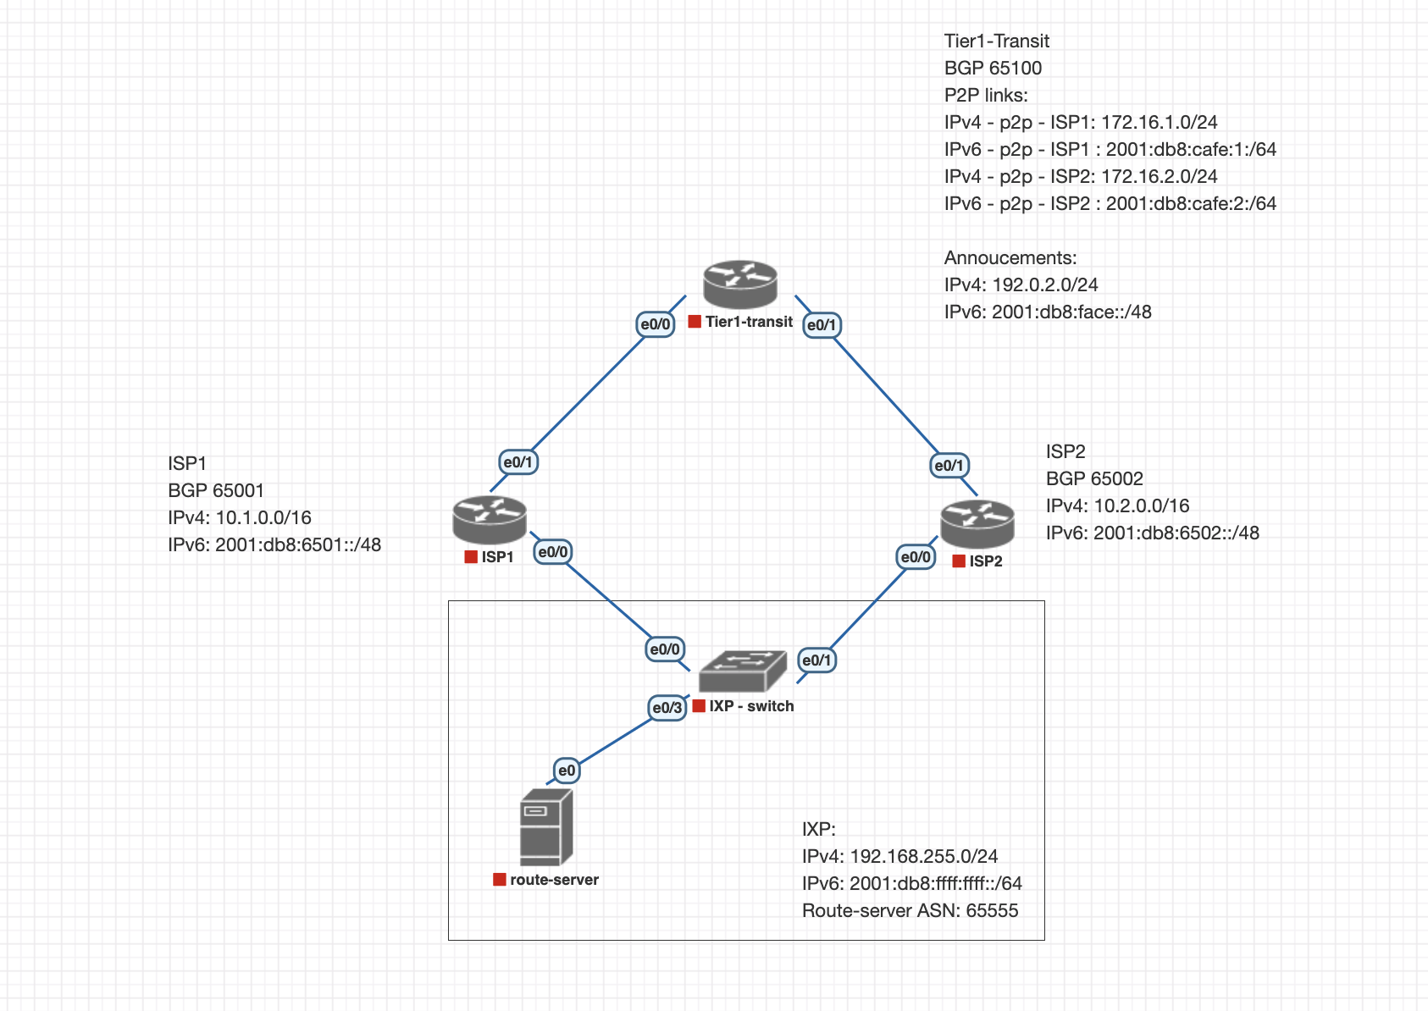
Topology

Slide 3
Always filter!
BGP sends the best paths to all neighbours - updated by RFC 8212 “Route Propagation Behavior without Policies”for eBGP
(config)# ip prefix-list TRANS-OUT-V4 seq 5 permit x.x.x.x/24

Slide 4
Set up BGP
Set up a static blackhole route for exporting routes
(config)# ip route x.x.x.x y.y.y.y null0
Set up BGP neighbor (e.g. on ISP1 vs tier1)
(config)# router bgp 65001
(config-router)# neighbor x.x.x.x remote-as 65100
(config-router)# address-family ipv4
(config-router-af)# neighbor x.x.x.x activate
(config-router-af)# neighbor x.x.x.x prefix-list TRANS-OUT-V4 out
(config-router-af)# network y.y.y.y z.z.z.z

Slide 5
Set-up route server
login: admin/N3tX0559
Basic settings:
(unknown)# system hostname rs
(rs)# interface e1 ipv4 address x.x.x.x/24
Set-up bird:
(rs)# router bird config-file bird.conf
(rs)# router bird edit
(rs)# router bird apply ! Apply changes in config

Slide 6
bird
Start and edit bird config
rs# router bird config-file bird.conf
No config file found. Building an initial config file in /etc/netc/bird/bird.conf Starting bird
rs# router bird config-file bird.conf edit
Edit the config file: see e.g. https://docs.netx.as/tutorials/bgp/basic-bgp.html
log "/var/log/bird.log" all;
log syslog { info, remote, warning, error, auth, fatal, bug };
template bgp BGP_BASE {
local as 65555;
export all;
rs client; # define route server
}
# create a BGP neigbor
protocol bgp AS65001 from BGP_BASE { neighbor xxxx as 65001; }
Save and apply config

Slide 7
Add RS community
Community 0:<peeras>
define myas = 65555;
function bgp_out(int) {
if ! (source = RTS_BGP ) then return false;
if (0,peeras) ~ bgp_community then return false;
if (myas,peeras) ~ bgp_community then return true;
if (0, myas) ~ bgp_community then return false;
return true;
}
protocol bgp AS65001 from BGP_BASE {
neighbor x.x.x.x as 65001;
ipv4 { export where bgp_out(65001); };
}
protocol bgp AS65002 from BGP_BASE {
neighbor y.y.y.y as 65002;
ipv4 { export where bgp_out(65002); };
}

Slide 8
Create route-map on ISP1
route-map disable_isp2 permit 10
set community 0:65002
neighbor 192.168.0.1 route-map disable_isp2 out
neighbor 192.168.0.1 send-community both

