Slide 1
Modern Network Security Threats
CCNASec Module 1
Notes:
Cisco Networking Academy Program
CCNP TSHOOT: Maintaining and Troubleshooting IP Networks
Chapter 1: Planning Maintenance for Complex Networks

Slide 2
Agenda
Introduction
Fundamental Principles of a Secure Network
Viruses, Worms, and Trojan Horses
Attack Methodologies
Cisco Network Foundation Protection Framework
Summary

Slide 3
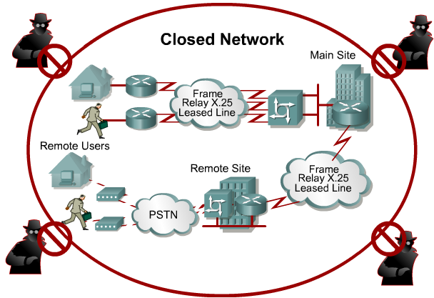
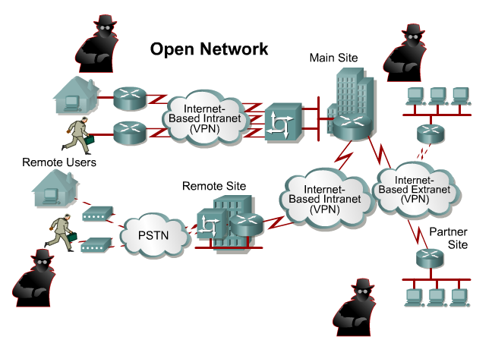
Purpose of Security
To protect assets!
  Historically done through physical security and closed networks
With the advent of personal computers, LANs, and the wide-open world of the Internet, the networks of today are more open.

Slide 4
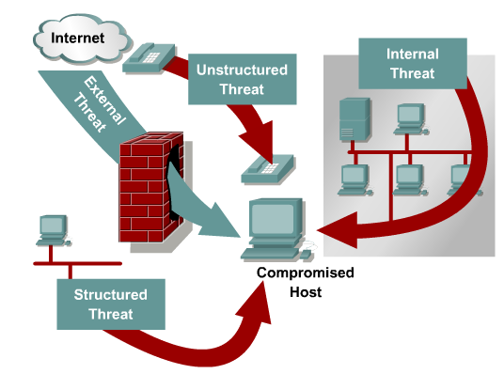
Threats
There are four primary classes of threats to network security:
  Unstructured threats
  Structured threats
  External threats
  Internal threats

Slide 5
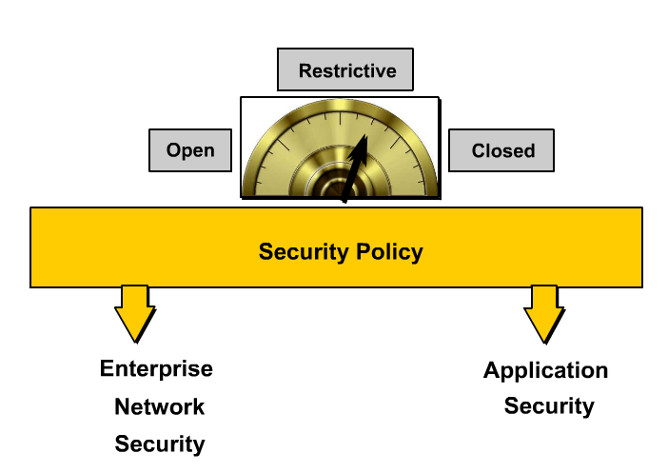
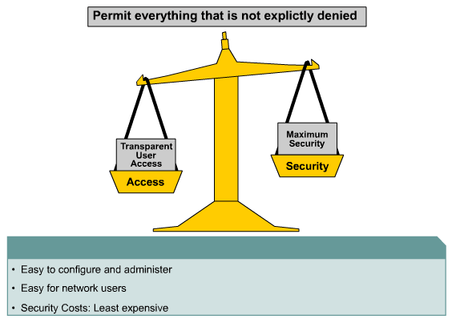
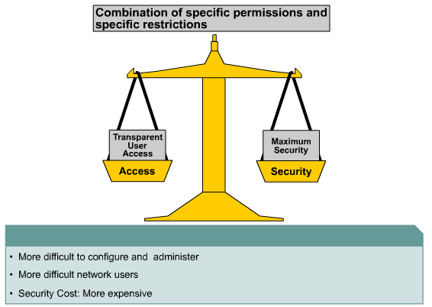
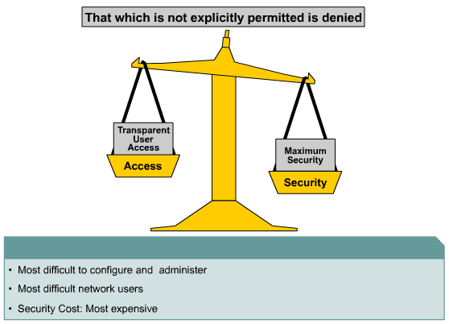
Network Security Models

Slide 6
Evolution of Network Security

Slide 7
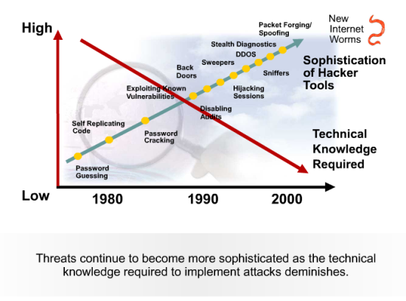
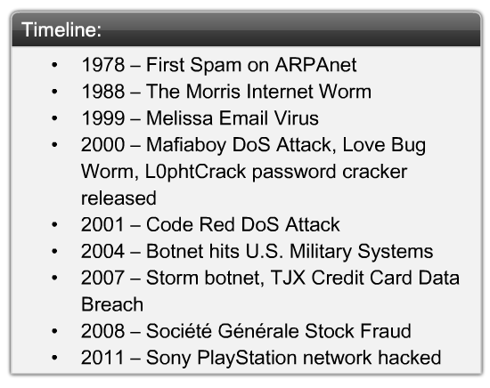
Sophistication of Tools vs. Technical Knowledge

Slide 8

Morris Worm
The Morris worm or Internet worm was the first computer worm distributed via the Internet
It was written by a student at Cornell University, Robert Tappan Morris, and launched on November 2, 1988 from MIT
The Morris worm worked by exploiting known vulnerabilities in Unix sendmail, Finger, rsh/rexec and weak passwords
It is usually reported that around 6,000 major Unix machines were infected by the Morris worm
  The cost of the damage was estimated at $10M–100M
It is considered the first worm and was certainly the first to gain significant mainstream media attention
  It also resulted in the first conviction in the US under the 1986 Computer Fraud and Abuse Act
  After appeals he was sentenced to three years probation, 400 hours of community service, and a fine of $10,000

Slide 9
Code Red
The Code Red worm was a DoS attack and was released on July 19, 2001 and attacked web servers globally, infecting over 350,000 hosts and in turn affected millions of users
Behavior
  Worm attempted to connect to TCP port 80 on a randomly chosen host assuming that a web server will be found
    Upon a successful connection to port 80, the attacking host sends a crafted HTTP GET request to the victim, attempting to exploit a buffer overflow in the Indexing Service
  The same exploit (HTTP GET request) is sent to other randomly chosen hosts due to the self-propagating nature of the worm
    However, depending on the configuration of the host which receives this request, there are varied consequence
  If the exploit was successful, the worm began executing on the victim host.
    In the earlier variant of the worm, victim hosts experienced the following defacement on all pages requested from the server:
      HELLO! Welcome to http://www.worm.com! Hacked By Chinese!
  Actual worm activity on a compromised machine was time sensitive and different activity occurred based on the date of the system clock:
    Day 1 - 19: The infected host will attempt to connect to TCP port 80 of randomly chosen IP addresses in order to further propagate the worm.
    Day 20 - 27: A packet-flooding denial of service attack will be launched against a particular fixed IP address.
    Day 28 - end of the month: The worm "sleeps"; no active connections or denial of service.
Although the worm resides entirely in memory, a reboot of the machine will purge it from the system
  However, patching the system for the underlying vulnerability remains imperative since the likelihood of re-infection is quite high due to the rapid propagation of the worm

Slide 10
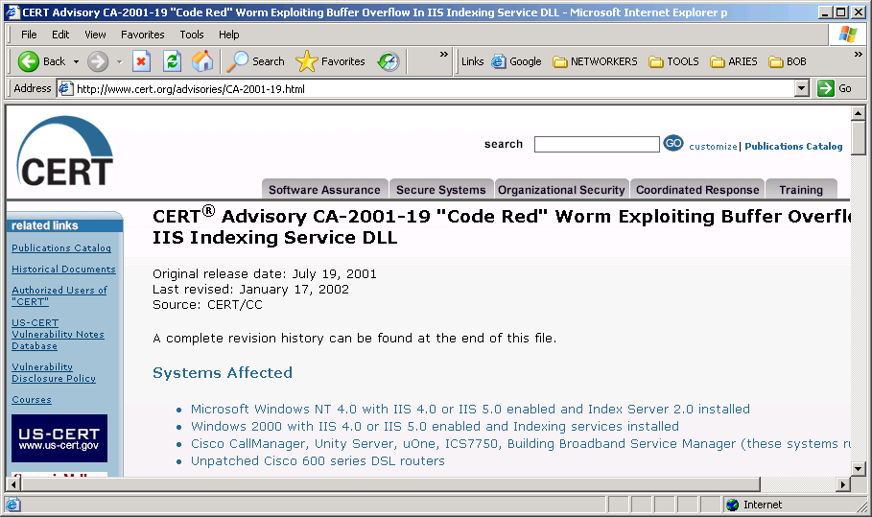
CERT Code Red
http://www.cert.org/advisories/CA-2001-19.html

Slide 11
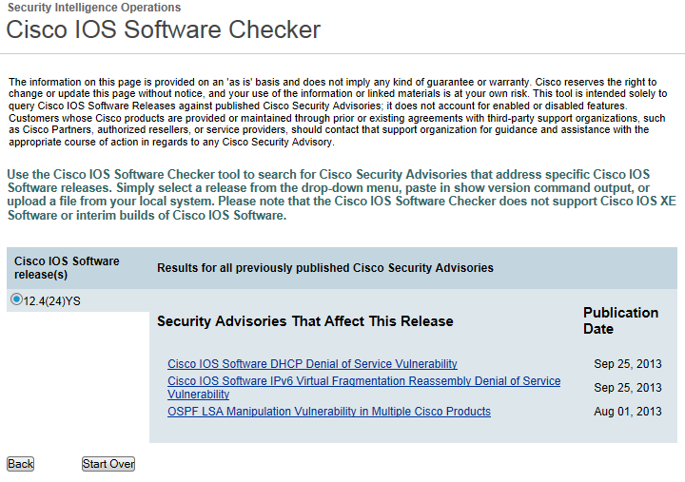
New Cisco Tool!
Cisco IOS Checker
  http://tools.cisco.com/security/center/selectIOSVersion.x

Slide 12
Drivers for Network Security

Slide 13

Hacker Titles
White hat
  Term used to describe individuals that use their abilities to find vulnerabilities in systems or networks, and then report these vulnerabilities to the owners of the system so that they can be fixed.
Black hat
  Term for individuals that use their knowledge of computer systems to break into systems or networks that they are not authorized to use.
Hacker
  General term that has historically been used to describe a computer programming expert.
Cracker
  Term that describes someone which attempts to gain unauthorized access with malicious intent.

Slide 14


Hacker Titles
Phreaker
  An individual that manipulates the phone network in order to cause it to perform a function that is normally not allowed such as to make free long distance calls
  Captain Crunch (John Drapper)
Spammer
  Individual that sends large quantities of unsolicited email messages.
  Spammers often use viruses to take control of home computers to send out their bulk messages.
Phisher
  Individual uses email or other means in an attempt to trick others into providing sensitive information, such as credit card numbers or passwords.

Slide 15
Evolution of Security Threats
1960s – 1970s: Phreaks
Early 1980s: Wardialing (telephone number scans)
1988: First Internet Worm
1993: First Def Noc Hacking Conference
1994: First 5 year federal prison sentence
1995: Kivin Mitnick sentenced for hacking credit cards
September 1997: Nmap published
1997: Script kiddies start appearing
Late 1990s: Wardriving (WiFi seeking)
2002: Melissa Virus creater gets 20 months
2006: Vishing (= voice phising), Smishing (= SMS phising)
2009: First malicious iPhone worm
2011: NBC Twitter account hacked by script kiddies

Slide 16
Evolution of Network Security Tools
1988 – DEC Packet Filter Firewall
1989 – AT&T Bell Labs Stateful Firewall
1991 – DEC SEAL Application Layer Firewall
1994 – Check Point Firewall
1995 – NetRanger IDS
1997 – RealSecure IDS
1998 – Snort IDS
1999 – First IPS
2006 – Cisco Zone-Based Policy Firewall

Slide 17
Evolution of Data Protection Technologies
1993 – Cisco GRE Tunnels
1996 – Site-to-Site VPNs
1999 – SSH
2000 – MPLS VPNs
2001 – Remote-Access IPsec VPN
2002 – Dynamic Multipoint VPN
2005 – SSL VPN
2009 – Group Encrypted Transport VPN (GET VPN)

Slide 18
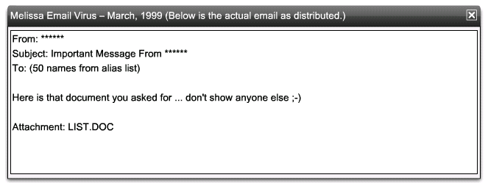
First Email Virus
The first email virus, the Melissa virus, was written by David Smith and resulted in memory overflows in Internet mail servers.
  David Smith was sentenced to 20 months in federal prison and a US$5,000 fine.

Slide 19
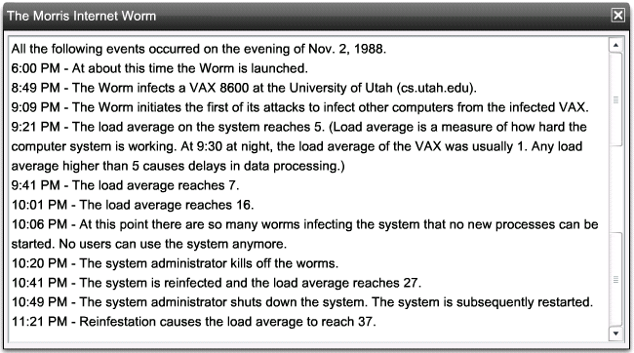
First Worm
Robert Morris created the first Internet worm with 99 lines of code.
  When the Morris Worm was released, 10% of Internet systems were brought to a halt.

Slide 20
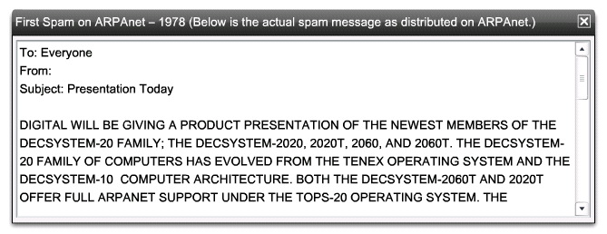
First SPAM

Slide 21

First DoS Attack
MafiaBoy was the Internet alias of Michael Calce, a 17 year old high school student from Montreal, Canada.
He launched highly publicized DoS attacks in Feb 2000 against Yahoo!, Amazon.com, Dell, Inc., E*TRADE, eBay, and CNN.
In 2001, The Montreal Youth Court sentenced him on September 12, 2001 to eight months of "open custody," one year of probation, restricted use of the Internet, and a small fine.
In 2005, Mr. Calce wrote as a columnist on computer security topics for the Francophone newspaper Le Journal de Montréal.

Slide 22
Trends Driving Network Security
Increase of network attacks
Increased sophistication of attacks
Increased dependence on the network
Wireless access
Lack of trained personnel
Lack of awareness
Lack of security policies
Legislation
Litigation
Notes:
Hackers
White Hat
Black Hat
Attack tools, worms, etc
Legislation
GLB
HIPPA
CIPA
Privacy Act
Litigation
Network Insurance against losses
Remember, these are why many companies are allocating the money for security initiatives.

Slide 23
Network Security Organizations

Slide 24

Legal and Governmental Policy Issues
Organizations that operate vulnerable networks will face increasing and substantial liability.
  http://en.wikipedia.org/wiki/Information_security#Laws_and_regulations
US Federal legislation mandating security includes the following:
  Gramm-Leach-Blilely (GLB) bill financial services legislation
  Government Information Security Reform Act
  Health Insurance Portability and Accountability Act of 1996 (HIPAA)
  Children Internet Protection Act (CIPA)
  The Payment Card Industry Data Security Standard (PCI DSS)
  Sarbanes-Oxley Act of 2002

Slide 25
Information Security Organizations
Three of the more well-established network security organizations are:
  Computer Emergency Response Team (CERT)
  SysAdmin, Audit, Network, Security (SANS) Institute
  International Information Systems Security Certification Consortium (pronounce (ISC)2 as "I-S-C-squared")
Cisco also has the Security Intelligence Operations (SIO)

Slide 26
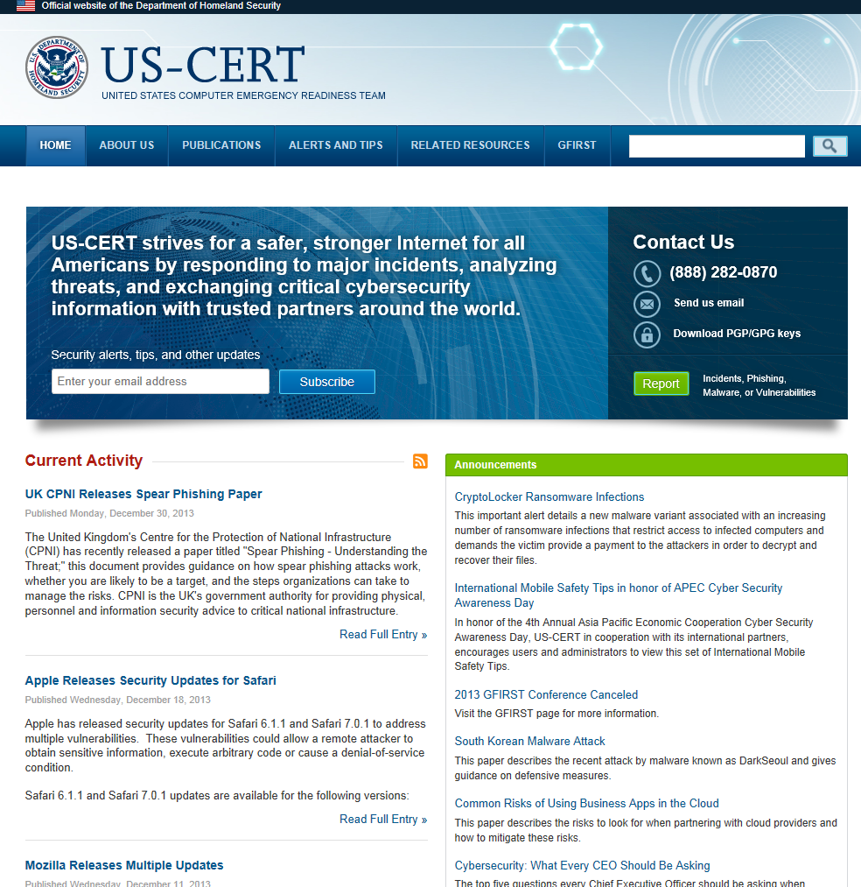
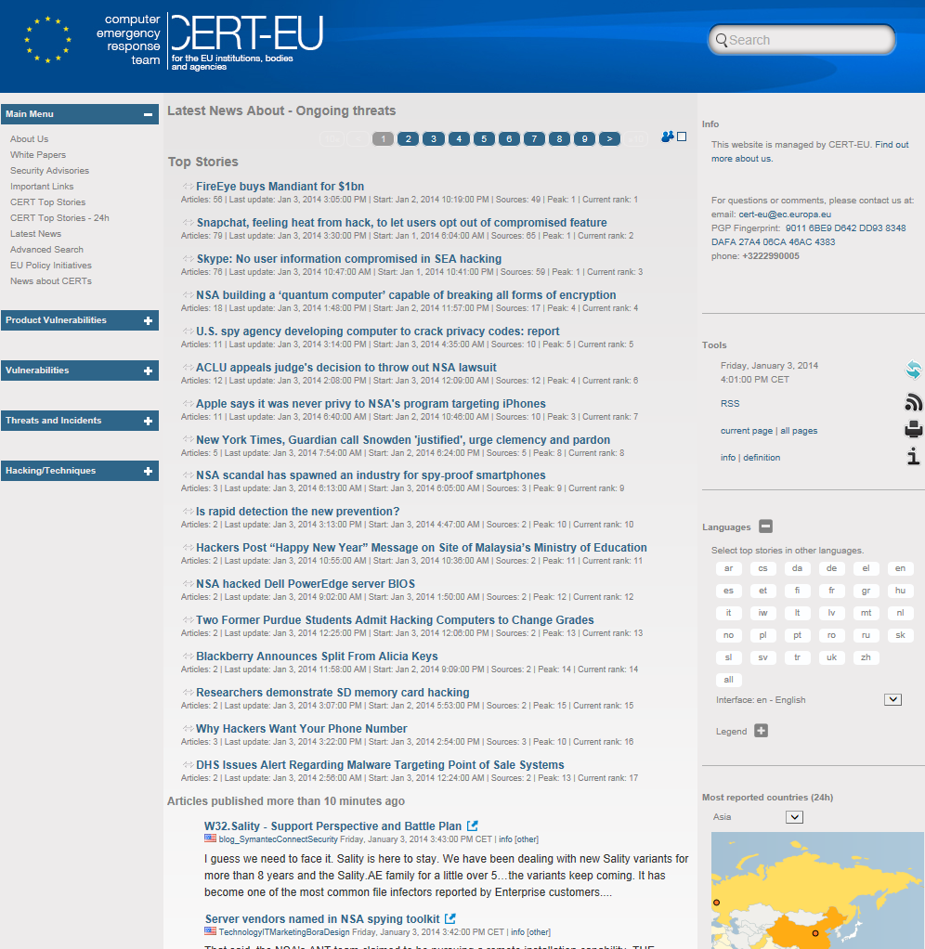
US-CERT EU-CERT

Slide 27
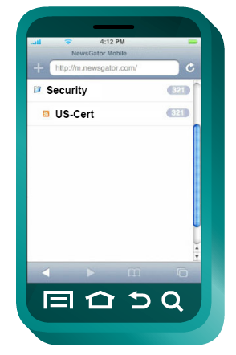
US-CERT RSS Feed
Really Simple Syndication (RSS) feeds provide a very useful tool for the network security professional.
By subscribing to RSS security feeds, such as the one available from Cisco's SIO http://tools.cisco.com/security/center, you receive security notifications when new information is available.
Notes:
Not in curriculum

Slide 28

SANS

Slide 29

(ISC)²

Slide 30
Network Security Polices and Domains

Slide 31
Domains of Network Security
It is also important to have an understanding of the various network security domains
  Domains provide an organized framework to facilitate learning about network security
ISO/IEC 27002 specifies 12 network security domains
  These 12 domains serve to organize at a high level the vast realm of information under the umbrella of network security
  The 12 domains are intended to serve as a common basis for developing organizational security standards and effective security management practices, and to help build confidence in inter-organizational activities

Slide 32
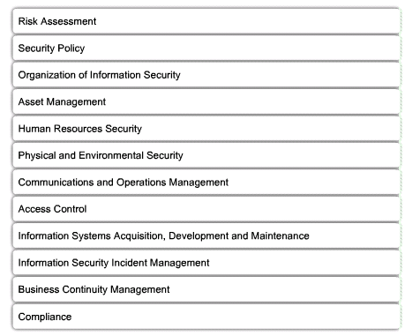
Domains of Network Security
Determine quantitative and qualitative value of risk
Document addressing constraints and behavior
Governance model of security
Inventory of classification scheme
Addresses security procedures relating to employees
Protection of computer facilities
Management of technical security controls
Restriction access rights to network, system, application, functions and data
Integration of security into application
Describes how to anticipate and respond to security breach
Protection, maintenance and recovery of bussiness-critical processes and systems
Process of ensuring conformance with information security policies, standards and regulations

Slide 33
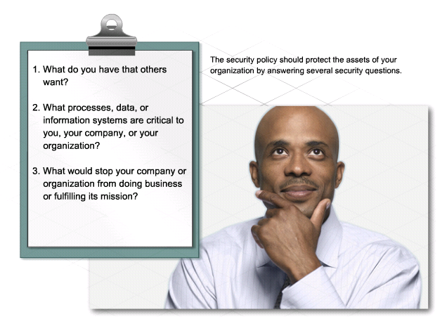
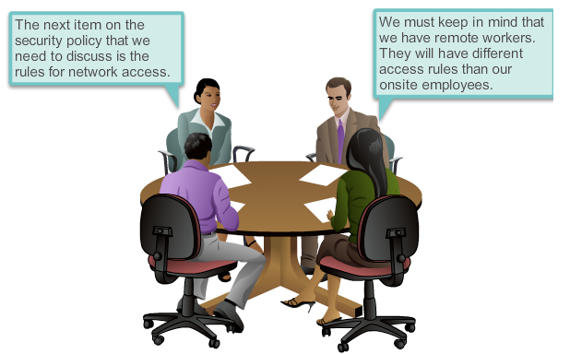
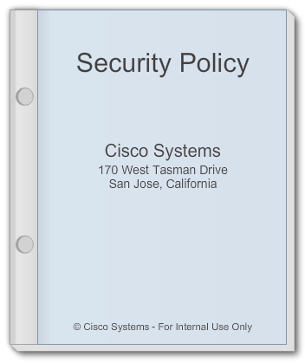
Security Policy

Slide 34
Cisco SecureX
This architecture includes the following five major components:
  Scanning Engines – Network level devices that examine content, authenticate users, and identify applications. They can include firewall/IPS, proxy or a fusion of both.
  Delivery Mechanisms – The way the scanning engine is implemented in the network. It can be via a standalone appliance, a blade in a router, or a software package.
  Security Intelligence Operations (SIO) – A traffic monitoring database, used to identify and stop malicious traffic.
  Policy Management Consoles – Policy creation and management that determines what actions the scanning engines will take.
  Next-generation Endpoint – Any variety of devices. All traffic to or from these devices are pointed to a scanner.

Slide 35
Malware /
Malicious Code

Slide 36

Malware
Malware = “Malicious software” is software designed to infiltrate a computer without the owner's informed consent
Malware includes:
  Computer viruses
  Worms
  Trojan horses
  Rootkits
  Backdoors (Method of bypassing normal authentication procedures and usually installed using Trojan horses or worms.)
  For profit (Spyware, botnets, keystroke loggers, and dialers)

Slide 37
Spyware
Spyware is a strictly for-profit category of malware designed to:
  Monitor a users web browsing
  Display unsolicited advertisements
  Redirect affiliate marketing revenues to the spyware creator
Spyware programs are generally installed by exploiting security holes or as Trojan horse programs such as most peer-to-peer applications

Slide 38
Viruses, Trojan horses, and Worms
A virus is malicious software that is attached to another program to execute a particular unwanted function on a user's workstation
  Virus can only spread from one computer to another by sending it over a network as a file or as an email payload or by carrying it on a removable medium
  Virus needs user intervention for infection
A worm executes arbitrary code and installs copies of itself in the infected computer’s memory, which infects other hosts
  They replicate themselves by independently exploiting vulnerabilities in networks
  Worm does not need user intervention
A Trojan horse is different only in that the entire application was written to look like something else, when in fact it is an attack tool
  Trojan horses are not self-replicating

Slide 39
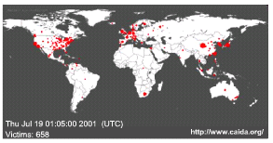

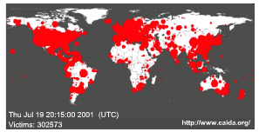
SQL Slammer Worms
In January 2001, the SQL Slammer Worm slowed down global Internet traffic as a result of DoS.
Over 250,000 hosts were affected within 30 minutes of its release.
The worm exploited a buffer overflow bug in Microsoft's SQL Server.
  A patch for this vulnerability was released in mid-2002, so the servers that were affected were those that did not have the update patch applied.

Slide 40
Trojan Horse Classification
Remote-access Trojan Horse
  Enables unauthorized remote access
Data sending Trojan Horse
  Provides the attacker with sensitive data such as passwords
Destructive Trojan Horse
  Corrupts or deletes files
Proxy Trojan Horse
  User's computer functions as a proxy server
Denial of Service Trojan Horse
  Slows or halts network activity

Slide 41
Five Phases of a Virus/Worm Attack
Probe phase
  Vulnerable targets are identified using ping scans.
  Application scans are used to identify operating systems and vulnerable software.
  Hackers obtain passwords using social engineering, dictionary attack, brute-force, or network sniffing.
Penetrate phase
  Exploit code is transferred to the vulnerable target.
  Goal is to get the target to execute the exploit code through an attack vector, such as a buffer overflow, ActiveX or Common Gateway Interface (CGI) vulnerabilities, or an email virus.
Persist phase
  After the attack is successfully launched in the memory, the code tries to persist on the target system.
  Goal is to ensure that the attacker code is running and available to the attacker even if the system reboots.
  Achieved by modifying system files, making registry changes, and installing new code.
Propagate phase
  The attacker attempts to extend the attack to other targets by looking for vulnerable neighboring machines.
  Propagation vectors include emailing copies of the attack to other systems, uploading files to other systems using file shares or FTP services, active web connections, and file transfers through Internet Relay Chat.
Paralyze phase
  Actual damage is done to the system.
  Files can be erased, systems can crash, information can be stolen, and distributed DDoS attacks can be launched.

Slide 42
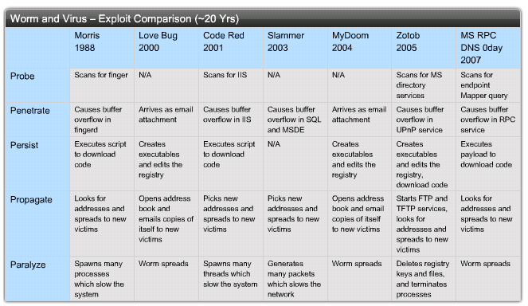
Exploit Comparison

Slide 43
Commonalities
A majority of the software vulnerabilities that are discovered relate to buffer overflows = program gains access out of the scope of its namespace
  Buffer overflows are usually the primary conduit through which viruses, worms, and Trojan Horses do their damage.
Viruses and Trojan Horses tend to take advantage of local root buffer overflows
  A root buffer overflow is intended to attain root privileges to a system – root kit
Worms such as SQL Slammer and Code Red exploit remote root buffer overflows
  Remote root buffer overflows are similar to local root buffer overflows, except that local end user or system intervention is not required

Slide 44
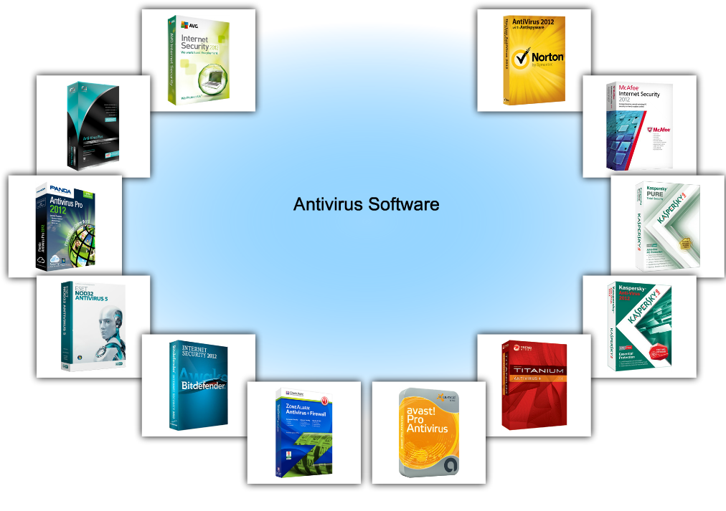
How Do You Mitigate Viruses and Worms?

Slide 45
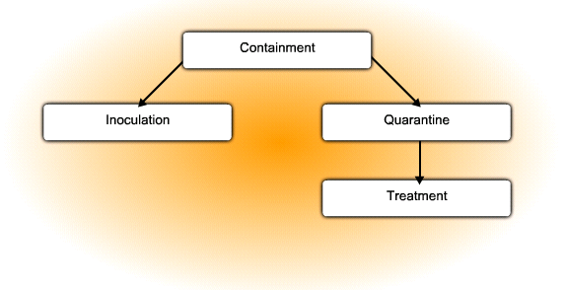
Mitigation
Containment Phase
  Limit the spread of a worm infection to areas
  of the network that are already affected.
  Compartmentalize and segment the network
  to slow down or stop the worm to prevent currently
  infected hosts from targeting and infecting
  other systems.
  Use both outgoing and incoming ACLs on routers
  and firewalls at control points within the network.
Inoculation Phase
  Runs parallel to or subsequent to the containment phase.
  All uninfected systems are patched with the appropriate vendor patch for the vulnerability.
  The inoculation process further deprives the worm of any available targets.
Quarantine Phase
  Track down and identify infected machines within the contained areas and disconnect, block, or remove them.
  This isolates these systems appropriately for the Treatment Phase.
Treatment Phase
  Actively infected systems are disinfected of the worm.
  Terminate the worm process, remove modified files or system settings that the worm introduced, and patch the vulnerability the worm used to exploit the system.
  In more severe cases, completely reinstalling the system to ensure that the worm and its by products are removed.

Slide 46
Reconnaissance Attacks

Slide 47
Reconnaissance
Reconnaissance also known as information gathering is the unauthorized discovery and mapping of systems, services, or vulnerabilities
  In most cases, precedes an access or DoS attack
Reconnaissance attacks can consist of the following:
  Internet information queries
  Ping sweeps
  Port scans
  Packet sniffers

Slide 48
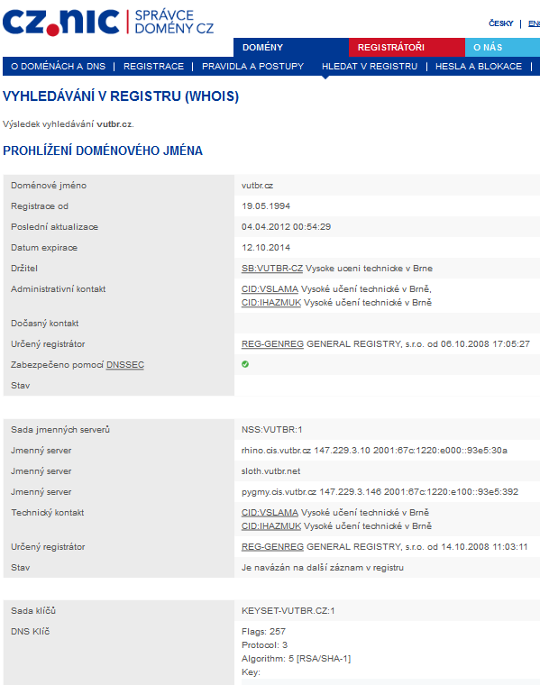
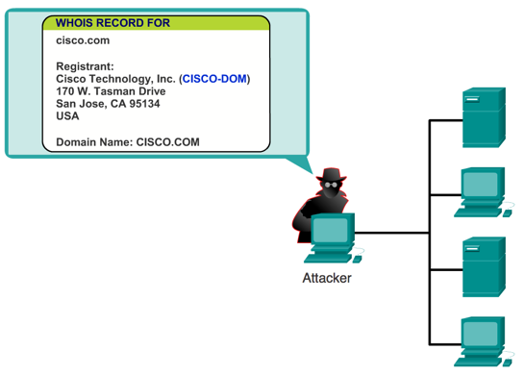
Internet Information Queries
DNS queries can reveal information such as who owns a particular domain and what addresses have been assigned to that domain.
  Use tools such as whois, nslookup, …

Slide 49
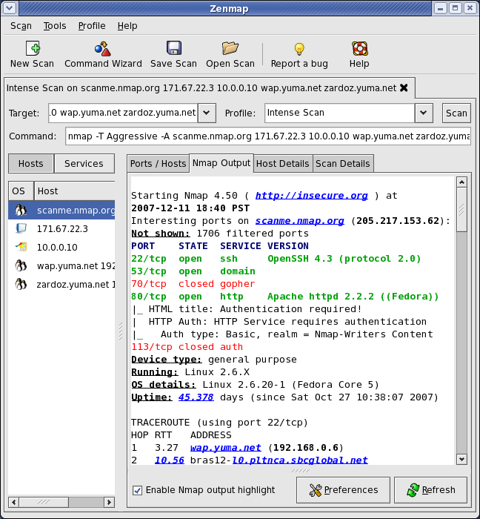
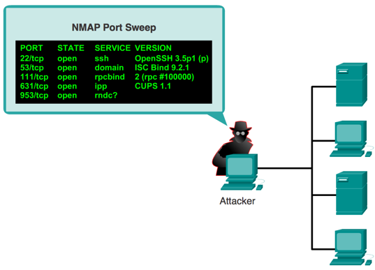
Ping Sweeps and Port Scans
A ping sweep, or ICMP sweep, scans to determine which range of IP addresses map to live hosts
A port scan consists of sending a message to each port, one port at a time
  Response received indicates whether the port is used and can therefore be probed for weakness
Tools like nmap, zenmap, cain&abel

Slide 50
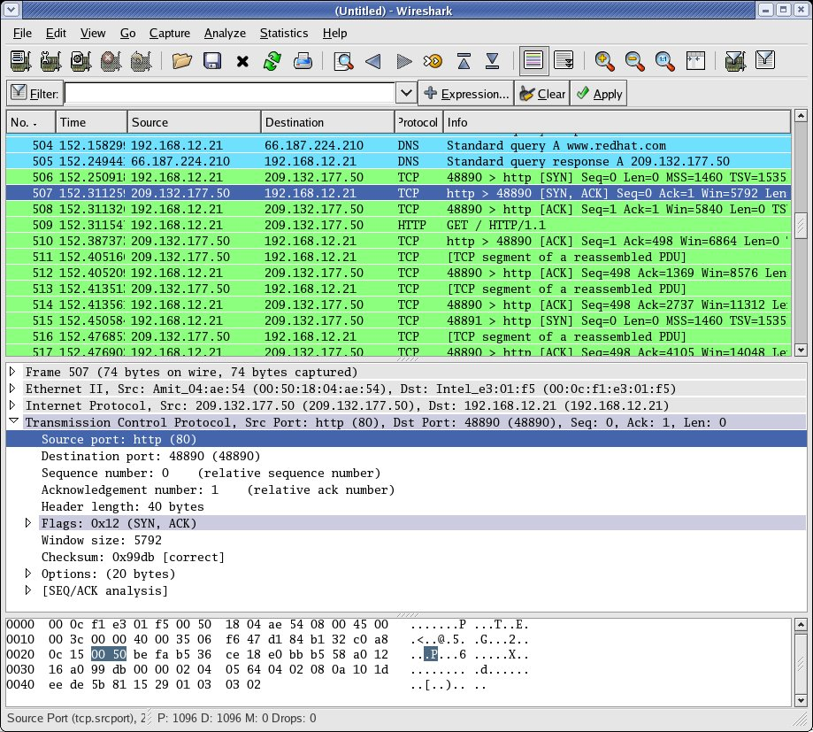
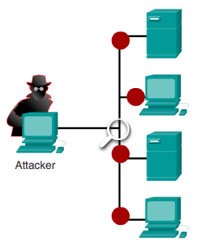
Packet Sniffing
A packet sniffer is a software application that uses a network adapter card in promiscuous mode to capture all network packets that are sent across a LAN
  Packet sniffers can only work in the same collision domain as the network being attacked
  Promiscuous mode is a mode in which the network adapter card sends all packets that are received on the physical network wire to an application for processing
  Wireshark is an example of a packet sniffer

Slide 51
Access Attacks

Slide 52
Access Attacks
Access attacks exploit known vulnerabilities in authentication services, FTP services, and web services to gain entry to web accounts, confidential databases, and other sensitive information for these reasons:
  Retrieve data
  Gain access
  Escalate their access privileges
Number of different ways, including:
  Password attacks
  Trust exploitation
  Port redirection
  Man-in-the-middle attacks
  Buffer overflow

Slide 53
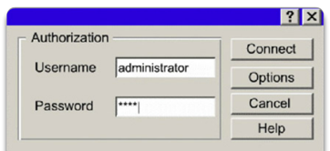
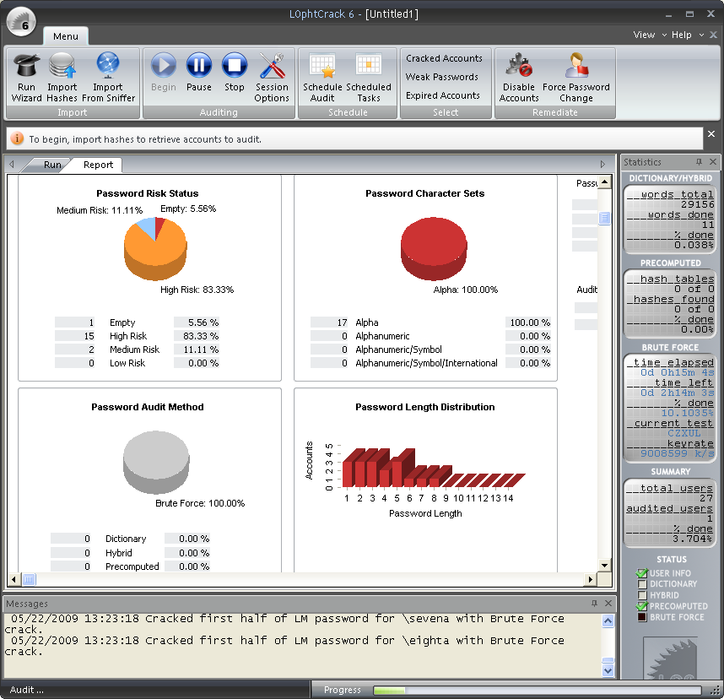
Password Attacks
Hackers implement password attacks using the following:
  Brute-force attacks
  Trojan horse programs
  IP spoofing
  Packet sniffers
Passwords are compromised using one of two methods:
  Dictionary cracking
  Brute-force computation

Slide 54
Trust Exploitation
Trust exploitation refers to an individual taking advantage of a trust relationship within a network
An example of when trust exploitation takes place is when a perimeter network is connected to a corporate network
  These network segments often contain DNS, SMTP, and HTTP servers
  Because these servers all reside on the same segment, a compromise of one system can lead to the compromise of other systems if those other systems also trust systems that are attached to the same network
Another example of trust exploitation is a Demilitarized Zone (DMZ) host that has a trust relationship with an inside host that is connected to the inside firewall interface.
  The inside host trusts the DMZ host
  When the DMZ host is compromised, the attacker can leverage that trust relationship to attack the inside host.

Slide 55
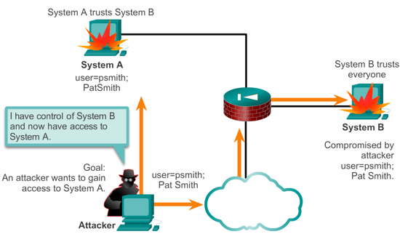
Trust Exploitation
A hacker leverages existing trust relationships.
Several trust models exist:
  Windows:
    Domains
    Active directory
  Linux and UNIX:
    NIS
    NIS+

Slide 56
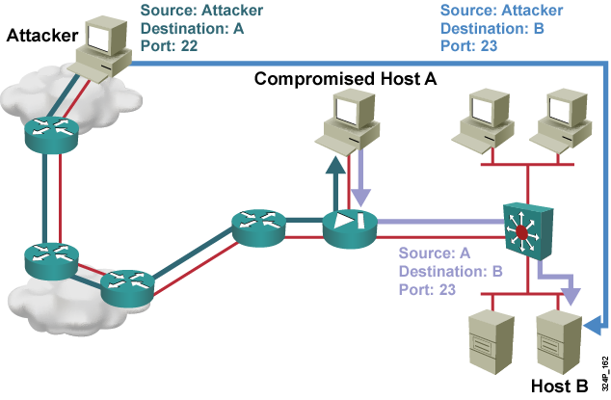
Port Redirection
A port redirection attack is a type of trust exploitation attack that uses a compromised host to pass traffic through a firewall that would otherwise have been dropped
  Port redirection bypasses the firewall rule sets by changing the normal source port for a type of network traffic.
  Assuming a system is under attack, an IPS can help detect a hacker and prevent installation of such utilities on a host.

Slide 57
“Man-in-the-Middle” Attacks
Man-in-the-middle attacks have these purposes:
  Theft of information
  Hijacking of an ongoing session to gain access to your internal network resources
  Traffic analysis to obtain information about your network and network users
  DoS
  Corruption of transmitted data
An example of a man-in-the-middle attack is when someone working for your ISP gains access to all network packets that transfer between your network and any other network.

Slide 58
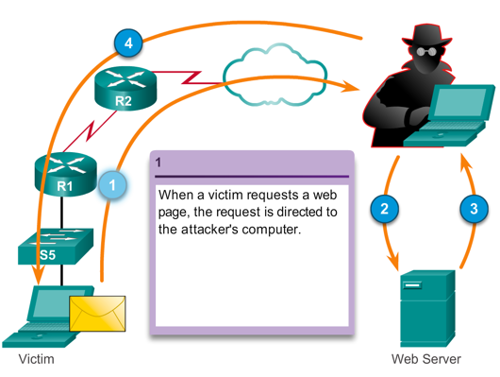
Man-in-the-Middle Attacks (MITM) Cont.

Slide 59
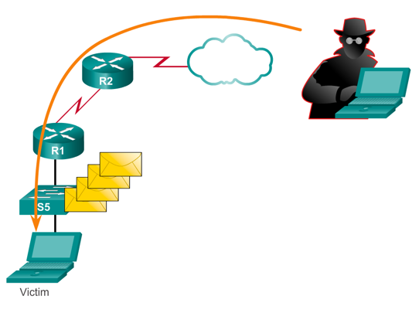
Buffer Overflow Attacks
A program writes data beyond the allocated buffer memory.
Buffer overflows usually arise as a consequence of a bug in a C or C++ program.
A result of the overflow is that valid data is overwritten or exploited to enable the execution of malicious code.
The overflow can be used to modify the values of program variables and cause the program to jump to unintended places, or even replace valid program instructions with arbitrary code.

Slide 60
DoS and DDoS Attacks

Slide 61
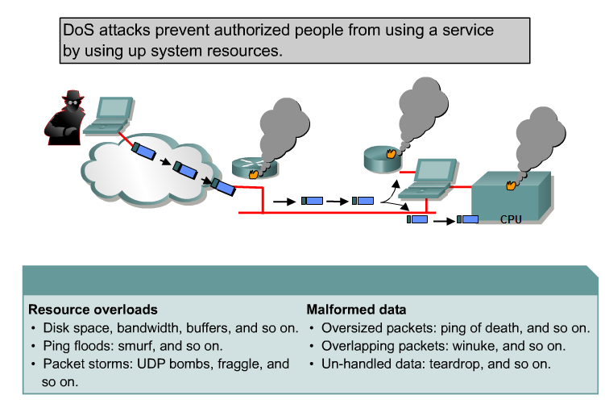
DoS Attacks

Slide 62
DoS Attack Types
Simple types of DoS attacks include:
  Ping of death
  Smurf Attack
  TCP SYN flood attack
Sophisticated include
  packet fragmentation and reassembly
  E-mail bombs
  CPU hogging
  Malicious applets
  Misconfiguring routers
  the chargen attack
  out-of-band attacks such as WinNuke, Land.c, Teardrop.c, and Targa.c.

Slide 63
Legacy DoS Attacks
Ping of Death
  Legacy attack that sent an echo request in an IP packet larger than the maximum packet size of 65,535 bytes
  A variant of this attack is to crash a system by sending ICMP fragments, which fill the reassembly buffers of the target
Smurf Attack
  This attack sends a large number of ICMP requests to directed broadcast addresses, all with spoofed source addresses on the same network as the respective directed broadcast.
SYN Flood Attack
  A flood of TCP SYN packets is sent, often with a forged sender address

Slide 64
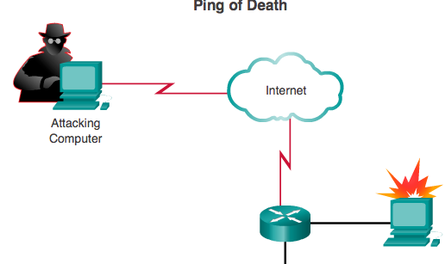
Ping of Death
Legacy attack that sent an echo request in an IP packet larger than the maximum packet size of 65,535 bytes. Sending a ping of this size can crash the target computer.
A variant of this attack is to crash a system by sending ICMP fragments, which fills the reassembly buffers of the target.

Slide 65
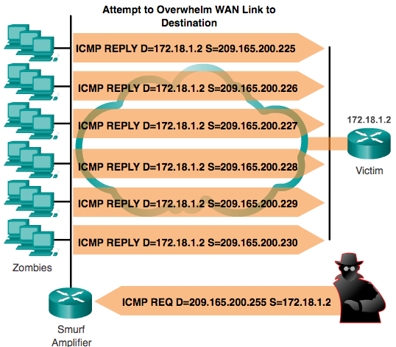
Smurf Attack Cont.

Slide 66
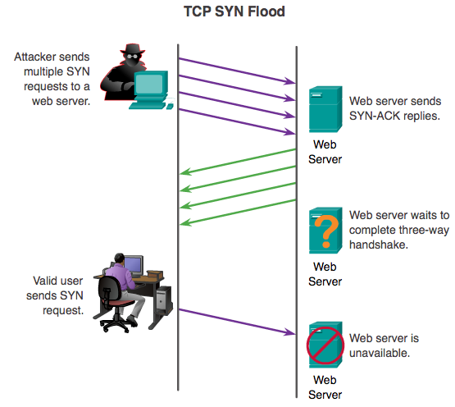
SYN Flood Attack

Slide 67
Distributed Denial of Service Attack (DoS)
DDoS attacks are designed to saturate network links with spurious data which can overwhelm a link causing legitimate traffic to be dropped.
  DDoS uses attack methods similar to standard DoS attacks but operates on a much larger scale
  Typically hundreds or thousands of attack points attempt to overwhelm a target
Examples of DDoS attacks include the following:
  Tribe Flood Network (TFN)
  Stacheldraht

Slide 68
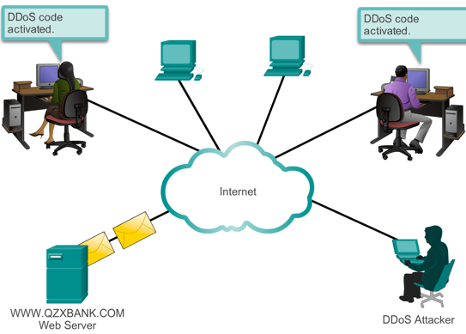
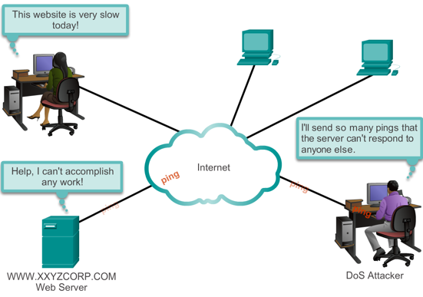

DDoS Example

Slide 69
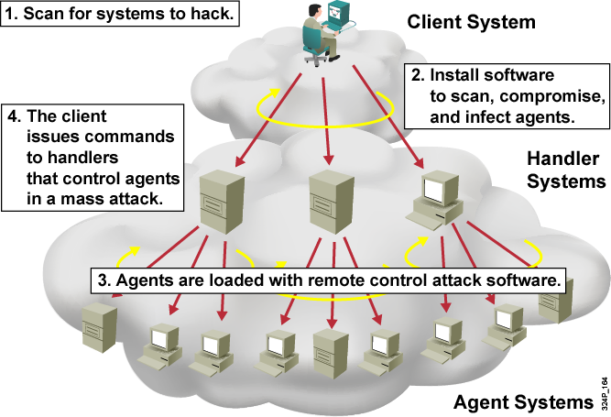
BotNet Example

Slide 70
Countermeasures

Slide 71
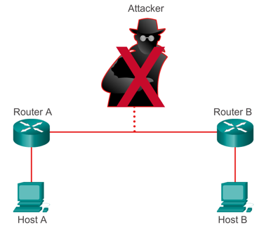
Reconnaissance Attacks Mitigation
Implementing and enforcing a policy directive that forbids the use of protocols with known susceptibilities to eavesdropping
Using encryption that meets the data security needs of the organization without imposing an excessive burden on the system resources or the users
Use anti-sniffer tools to detect sniffer attacks.
Using switched networks.
Use a firewall and IPS.

Slide 72
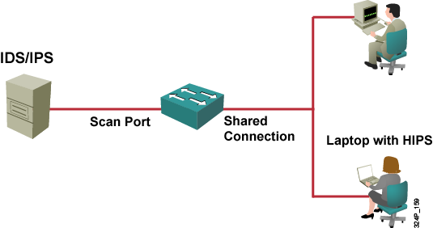
Port Scan and Ping Sweep Mitigation
Port scanning and ping sweeping is not a crime and there is no way to stop these scans and sweeps when a computer is connected to the Internet.
Ping sweeps can be stopped if ICMP echo and echo-reply are turned off on edge routers.
  When these services are turned off, network diagnostic data is lost.

Slide 73
Packet Sniffer Mitigation
Authentication
  Strong authentication is a first line for defense.
Cryptography
  If a communication channel is cryptographically secure, the only data a packet sniffer detects is cipher text.
Anti-sniffer tools
  Antisniffer tools detect changes in the response time of hosts to determine whether the hosts are processing more traffic than their own traffic loads would indicate.
Switched infrastructure
  A switched infrastructure obviously does not eliminate the threat of packet sniffers but can greatly reduce the sniffers’ effectiveness.

Slide 74
Password Attack Mitigation
Password attack mitigation techniques include:
  Do not allow users to use the same password on multiple systems
  Disable accounts after a certain number of unsuccessful login attempts
  Use OTP or a cryptographic password is recommended
  Use “strong” passwords that are at least eight characters long and contain uppercase letters, lowercase letters, numbers, and special characters
  Do not use plain text passwords

Slide 75
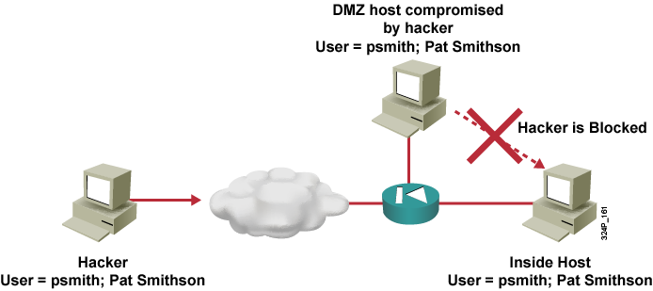
Trust Exploitation Attack Mitigation
Trust levels within a network should be tightly restrained by ensuring that systems inside a firewall never absolutely trust systems outside the firewall.

Slide 76
Man-in-the-Middle Mitigation
Man-in-the-middle attacks can be effectively mitigated only through the use of cryptography (encryption)
A man-in-the-middle attack can only see cipher text
IPSec tunnel
Host A
Host B
Router A
ISP
Router B

Slide 77
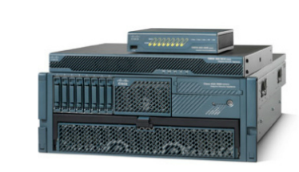
DoS and DDoS Attack Mitigation
Anti-DoS features on routers and firewalls:
  Proper configuration of anti-DoS features on routers and firewalls can help limit the effectiveness of an attack
  These features often involve limits on the amount of half-open TCP connections that a system allows at any given time
  An organization can implement traffic rate limiting with its Service Provider

Slide 78
IP Spoofing Attack Mitigation
Anti-spoof features on routers and firewalls:
  Proper configuration of anti-spoof features on your routers and firewalls can reduce your risk of attack
  These features include an appropriate filtering with access lists, unicast reverse path forwarding that looks up the routing table to identify spoofed packets, disabling of source route options, and others
The threat of IP spoofing can be reduced, but not eliminated, using these measures:
  Access control configuration
  Encryption
  RFC 3704 filtering
Additional authentication requirement that does not use IP address-based authentication; examples are:
  Cryptographic (recommended)
  Strong, two-factor, one-time passwords
Notes:
Access Control Configuration
The most common method for preventing IP spoofing is to properly configure access control. To reduce the effectiveness of IP spoofing, configure the access control list (ACL) to deny any traffic from the external network that has a source address that should reside on the internal network. This configuration helps to prevent spoofing attacks only if the internal addresses are the only trusted addresses. If some external addresses are trusted, this method is not effective.
Encryption
Another possible way to prevent IP spoofing is to encrypt all network traffic to prevent source and destination hosts from being compromised.
RFC 3704 Filtering
You can prevent your network users from spoofing other networks (and be a good Internet citizen at the same time) by preventing any outbound traffic on your network that does not have a source address in your the IP range of your organization. This filtering denies any traffic that does not have the source address that was expected on a particular interface. For example, if an ISP is providing a connection to the IP address 15.1.1.0/24, the ISP could filter traffic so that only traffic sourced from address 15.1.1.0/24 can enter the ISP router from that interface. Note that unless all ISPs implement this type of filtering, the effectiveness is significantly reduced.
RFC 3704 covers ingress filtering for multihomed networks. It updates RFC 2827.
RFC 2827 defines filters to drop packets that come from source addresses within 0.0.0.0/8, 10.0.0.0/8, 127.0.0.0/8, 172.16.0.0/12, 192.168.0.0/16, 224.0.0.0/4, or 240.0.0.0/4. This source address is a so-called Martian Address.
Additional Authentication
The most effective method for mitigating the threat of IP spoofing is to eliminate the attack’s effectiveness. IP spoofing can function correctly only when devices use IP address-based authentication; therefore, if you use additional authentication methods, IP spoofing attacks are irrelevant. Cryptographic authentication is the best form of additional authentication. However, when cryptographic authentication is not possible, strong two-factor authentication using OTPs can also be effective.

Slide 79
10 Best Practices
Keep patches up to date by installing them weekly or daily, if possible, to prevent buffer overflow and privilege escalation attacks.
Shut down unnecessary services and ports.
Use strong passwords and change them often.
Control physical access to systems.
Avoid unnecessary web page inputs.
  Some websites allow users to enter usernames and passwords.
  A hacker can enter more than just a username.
  For example, entering "jdoe; rm -rf /" might allow an attacker to remove the root file system from a UNIX server.
  Programmers should limit input characters and not accept invalid characters such as | ; < > as input.
Perform backups and test the backed up files on a regular basis.
Educate employees about the risks of social engineering, and develop strategies to validate identities over the phone, via email, or in person.
  http://www.networkworld.com/news/2010/091610-social-networks.html?source=NWWNLE_nlt_daily_pm_2010-09-16
  http://searchsecurity.techtarget.com/news/1519804/Phishing-attacks-target-users-of-Facebook-other-social-networks?asrc=EM_NLN_12420860&track=NL-102&ad=784799&
Encrypt and password-protect sensitive data.
Implement security hardware and software such as firewalls, IPSs, virtual private network (VPN) devices, anti-virus software, and content filtering.
Develop a written security policy for the company.

Slide 80
Thinking Like a Hacker

Slide 81

Know Thine Enemy
"If you know yourself but not your enemy, for every victory gained you will also suffer a defeat."
  Sun Tzu – The Art of War
Before learning how to defend against attacks, you need to know how a potential attacker operates.

Slide 82
Seven Steps to Hacking a Network
Perform footprint analysis (reconnaissance)
Detail the information
Manipulate users to gain access
Escalate privileges
Gather additional passwords and secrets
Install back doors
Leverage the compromised system

Slide 83
Software Tools
A great deal of hacker tools are available:
  Netcat: Netcat is a featured networking utility that reads and writes data across network connections using the TCP/IP protocol.
  Microsoft EPDump and Remote Procedure Call (RPC) Dump: These tools provide information about Microsoft RPC services on a server:
    The Microsoft EPDump application shows what is running and waiting on dynamically assigned ports.
    The RPC Dump (rpcdump.exe) application is a command-line tool that queries RPC endpoints for status and other information on RPC.
  GetMAC: This application provides a quick way to find the MAC (Ethernet) layer address and binding order for a computer running Microsoft Windows 2000 locally or across a network.
  Software development kits (SDKs): SDKs provide hackers with the basic tools that they need to learn more about systems.
Notes:
Netcat: You can use Netcat directly or driven by other programs and scripts as a reliable back-end tool. Netcat is a feature-rich network debugging and exploration tool because it can create almost any kind of connection you would need and has several interesting built-in capabilities. Hackers use Netcat to grab banners and to scan ports. You will use it in an upcoming lab exercise to find vulnerabilities in your own network. You will find Netcat at: http://netcat.sourceforge.net/
GetMAC: This application is useful when you want to enter the address into a sniffer, or if you need to know what protocols are currently in use on a computer. For more information, see: http://www.microsoft.com/windows2000/techinfo/reskit/tools/existing/getmac-o.asp
Microsoft Windows SDK provides the documentation, samples, header files, libraries, and tools that you need to develop applications that run on Microsoft Windows. See the Microsoft site at: http://www.microsoft.com/downloads/details.aspx?FamilyId=A55B6B43-E24F-4EA3-A93E-40C0EC4F68E5&displaylang=en

Slide 84
Common Social Engineering Methods
Posing as a fellow employee, as an employee of a vendor, partner company, or law enforcement, as someone in authority, as a new employee requesting help, as a vendor or systems manufacturer calling to offer a system patch or update.
Offering help if a problem occurs, then making the problem occur, thereby manipulating the victim to call them for help.
Sending free software or patch for victim to install.
Sending a virus or Trojan Horse as an email attachment.
Using a false pop-up window asking user to log in again or sign on with password.
Leaving a USB stick, or CD around the workplace with malicious software on it.
Using insider lingo and terminology to gain trust.
Offering a prize for registering at a Web site with username and password.
Dropping a document or file at company mail room for intra-office delivery.
Modifying fax machine heading to appear to come from an internal location.
Asking receptionist to receive then forward a fax.
Asking for a file to be transferred to an apparently internal location.
Getting a voice mailbox set up so call backs perceive attacker as internal.
Pretending to be from remote office and asking for email access locally.

Slide 85
Warning Signs of an Attack
Refusal to give call back number
Out-of-ordinary request
Claim of authority
Stresses urgency
Threatens negative consequences of non compliance
Shows discomfort when questioned
Name dropping
Compliments or flattery
Flirting

Slide 86
Cisco Network Foundation Protection (NFP)

Slide 87
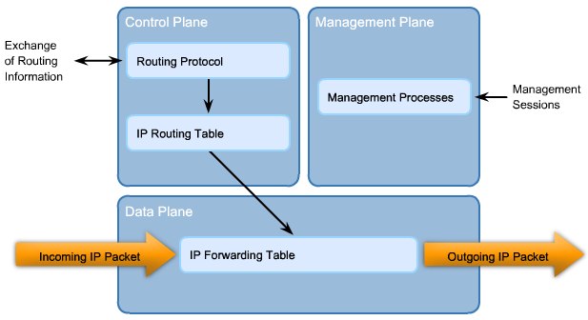
Cisco Network Foundation Protection (NFP)
NFP logically divides routers and switches into three functional areas:
  Control Plane - Responsible for routing data correctly. Consists of device-generated packets required for the operation of the network itself such as ARP message exchanges or OSPF routing advertisements.
  Management Plane - Responsible for managing network elements. Generated either by network devices or network management stations using processes and protocols such as Telnet, SSH, TFTP, FTP, NTP, AAA, SNMP, syslog, TACACS+, RADIUS, and NetFlow.
  Data Plane (Forwarding Plane) - Responsible for forwarding data. Consists of user-generated packets being forwarded between end stations. Most traffic travels through the router, or switch, via the data plane.

Slide 88

Securing the Control Plane
Cisco AutoSecure provides a one-step lockdown for the control, management and data planes.
Routing protocol authentication prevents the router from accepting fraudulent routing updates.
Control Plane Policing (CoPP) prevents unnecessary traffic from overwhelming the route processor. CoPP treats the control plane as a separate entity and applies rules to the input and output ports.

Slide 89
Securing the Control Plane
CoPP is designed to prevent unnecessary traffic from overwhelming the route processor.
CoPP consists of the following features:
  Control Plane Policing (CoPP) - Allows users to configure a QoS filter that manages the traffic flow of control plane packets. This protects the control plane against reconnaissance and DoS attacks.
  Control Plane Protection (CPPr) - An extension of CoPP that allows for policing granularity. For example, CPPr can filter and rate-limit the packets that go to the control plane of the router and discard malicious and error packets (or both).
  Control Plane Logging - Enables the logging of packets that CoPP or CPPr drop or permit. It provides the logging mechanism needed to deploy, monitor, and troubleshoot CoPP features efficiently.

Slide 90
Securing the Management Plane
Implement a login and password policy to restrict device accessibility.
Present legal notification developed by legal counsel of a corporation.
Ensure the confidentiality of data by using management protocols with strong authentication.
Use role-based access control (RBAC) to ensure that access is only granted to authenticated users, groups, and services.
Restrict the actions and views that are permitted by any particular user, group, or service.
Enable management access reporting to log and account for all access.

Slide 91
Securing the Data Plane
Use ACLs to perform packet filtering. ACLs can be used to:
  Block unwanted traffic or users.
  Reduce the change of a DoS attack.
  Mitigate spoofing attacks.
  Provide bandwidth control.
  Classify traffic to protect the management and control planes.
Implement Layer 2 security using:
  Port security
  DHCP snooping
  Dynamic ARP Inspection (DAI)
  IP Source Guard

Slide 92
Slides adapted by Vladimír Veselý
partially from official course materials
Last update: 2015-07-05

